Slide 1

OpenAI API
Chat
Completions
Three

Slide 2
Going Deeper
user
metadata
store
service_tier
stream_options
seed
modalities
n

Slide 3
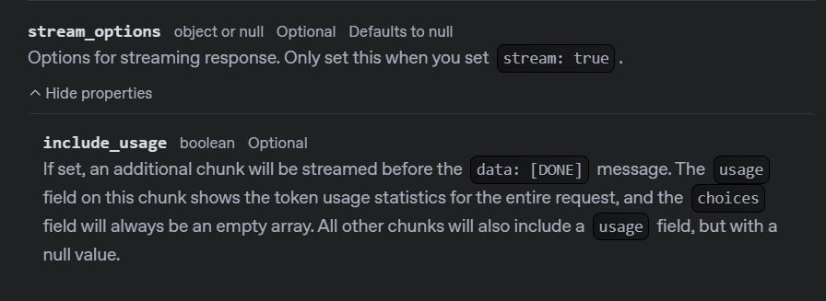
Notes:
https://platform.openai.com/docs/api-reference/chat/create#chat-create-stream_options

Slide 4
stream = client.chat.completions.create(
model="gpt-4o-mini",
messages=[
{"role": "system", "content": "You are a brilliant author of children's books."},
{"role": "user", "content": "Write one paragraph about a frog."}
],
stream=True,
stream_options={"include_usage": True}
)
for chunk in stream:
# Handle content chunks
if hasattr(chunk, 'choices') and len(chunk.choices) > 0:
if chunk.choices[0].delta.content is not None:
print(chunk.choices[0].delta.content, end="")
# Handle usage or other non-content chunks
elif hasattr(chunk, 'usage') and chunk.usage is not None:
print("\n\nUsage Statistics:")
print(f"Prompt Tokens: {chunk.usage.prompt_tokens}")
print(f"Completion Tokens: {chunk.usage.completion_tokens}")
print(f"Total Tokens: {chunk.usage.total_tokens}")

Slide 5
DEMO: Stream Options

Slide 6




Notes:
https://www.youtube.com/channel/UC35ZpwldGw7ZJ5R-2sLijzw

Slide 7
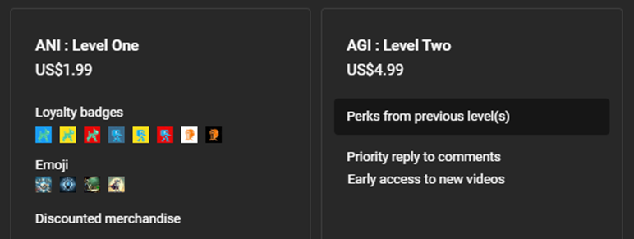
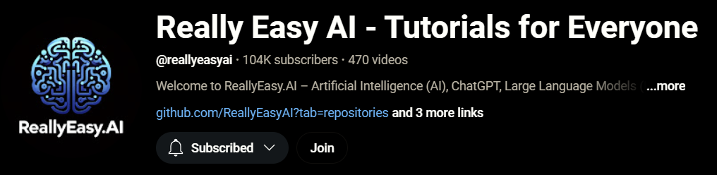
Notes:
https://www.youtube.com/@reallyeasyai/join

Slide 8

https://shop.reallyeasy.ai
Notes:
https://shop.reallyeasy.ai

Slide 9

https://www.youtube.com/@ainewsfresh
Notes:
https://www.youtube.com/@ainewsfresh

Slide 10

https://www.youtube.com/@aipaperspodcastdaily
Notes:
https://www.youtube.com/@aipaperspodcastdaily

Slide 11
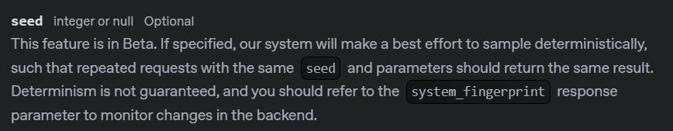
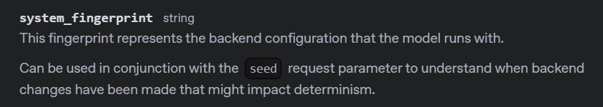
Notes:
https://platform.openai.com/docs/api-reference/chat/create#chat-create-seed
https://platform.openai.com/docs/api-reference/completions/object#completions/object-system_fingerprint

Slide 12
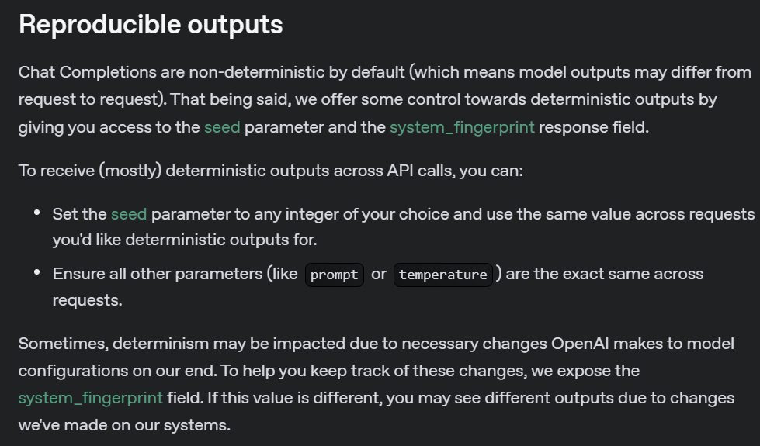
Notes:
https://platform.openai.com/docs/advanced-usage#reproducible-outputs

Slide 13
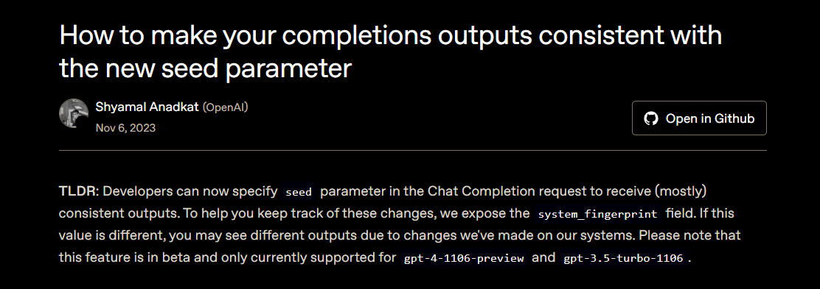
Notes:
https://cookbook.openai.com/examples/reproducible_outputs_with_the_seed_parameter
https://github.com/openai/openai-cookbook/blob/main/examples/Reproducible_outputs_with_the_seed_parameter.ipynb

Slide 14
DEMO: Seed

Slide 15
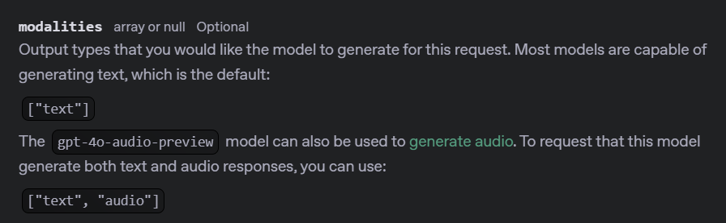
Notes:
https://platform.openai.com/docs/api-reference/chat/create#chat-create-modalities

Slide 16
stream = client.chat.completions.create(
model="gpt-4o-mini",
messages=[
{"role": "developer", "content": "You are a brilliant author of children's books."},
{"role": "user", "content": "Write two paragraphs about a frog."}
],
response_format=None,
temperature=None,
max_completion_tokens=None,
stop=None,
top_p=None,
frequency_penalty=None,
presence_penalty=None,
stream=True,
modalities=["text"],
)

Slide 17
DEMO: Modalities (Text)

Slide 18
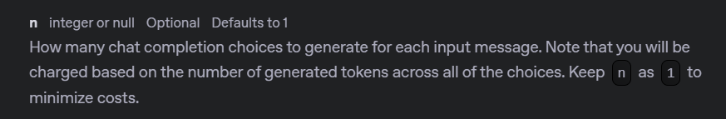
Notes:
https://platform.openai.com/docs/api-reference/chat/create#chat-create-n

Slide 19
response = client.chat.completions.create(
model="gpt-4o-mini",
messages=[
{"role": "developer", "content": "You are a brilliant author of children's books."},
{"role": "user", "content": "Write two paragraphs about a frog."}
],
response_format=None,
temperature=None,
max_completion_tokens=None,
stop=None,
top_p=None,
frequency_penalty=None,
presence_penalty=None,
stream=False,
n=3,
)

Slide 20
DEMO: N Completions

Slide 21
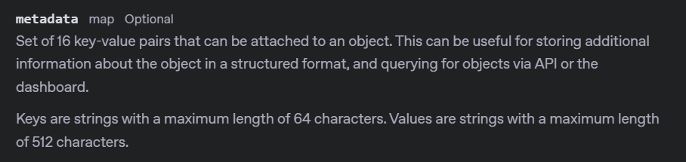
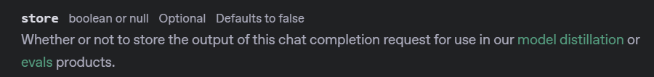
Notes:
https://platform.openai.com/docs/api-reference/chat/create#chat-create-user
https://platform.openai.com/docs/api-reference/chat/create#chat-create-metadata
https://platform.openai.com/docs/api-reference/chat/create#chat-create-store

Slide 22
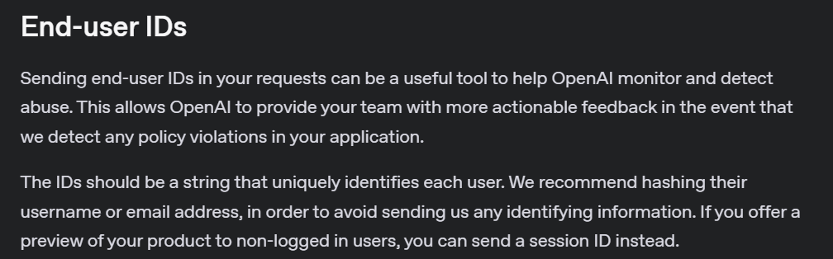
Notes:
https://platform.openai.com/docs/guides/safety-best-practices#end-user-ids

Slide 23
stream = client.chat.completions.create(
model="gpt-4o-mini",
messages=[
{"role": "developer", "content": "You are a brilliant author of children's books."},
{"role": "user", "content": "Write two paragraphs about a frog."}
],
stream=True,
user="user_id_123",
store=True,
metadata={
"project": "Frog Adventures Book Series",
"audience_age": "5-8",
"priority": "medium",
"genre": "educational fiction"
},
)

Slide 24
DEMO: User, Metadata, and Store

Slide 25
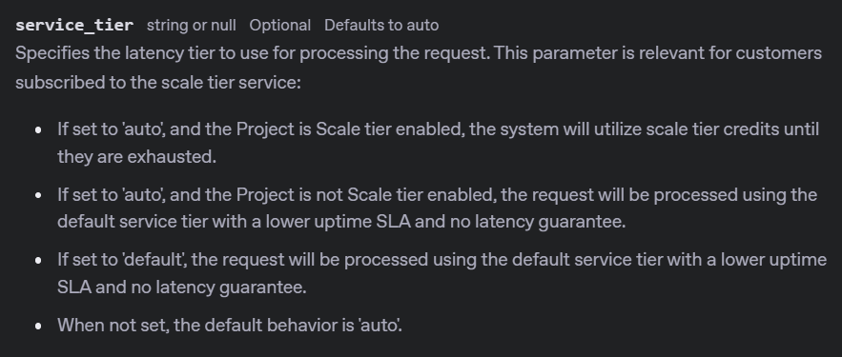
Notes:
https://platform.openai.com/docs/api-reference/chat/create#chat-create-service_tier

Slide 26
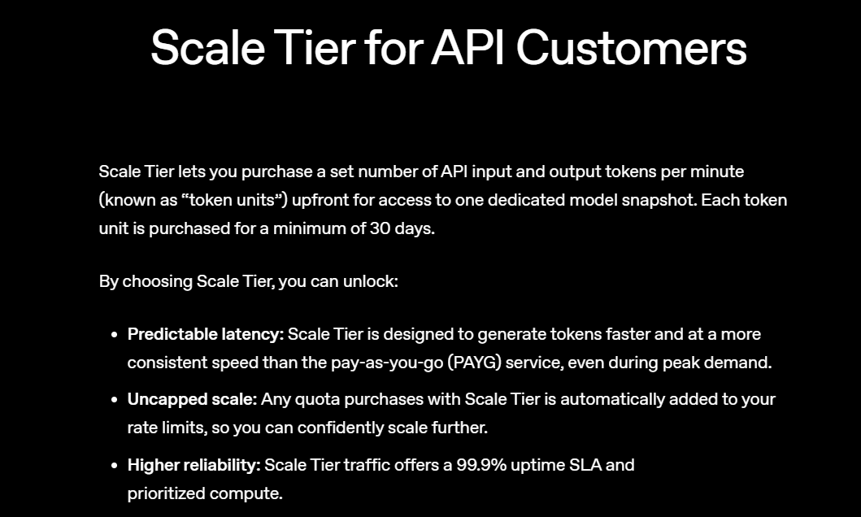
Notes:
https://openai.com/api-scale-tier/

Slide 27
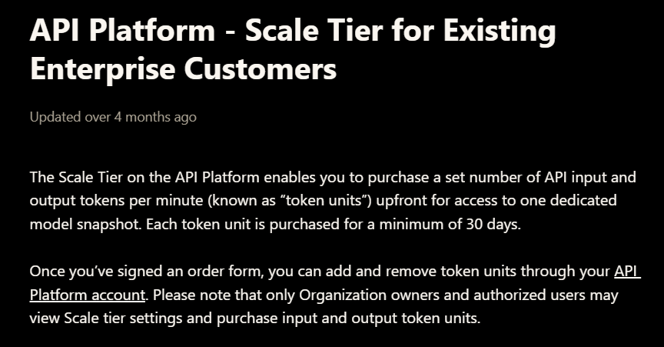
Notes:
https://help.openai.com/en/articles/9890166-api-platform-scale-tier-for-existing-enterprise-customers

Slide 28
OpenAI API
Chat
Completions
Three

